Slide 1
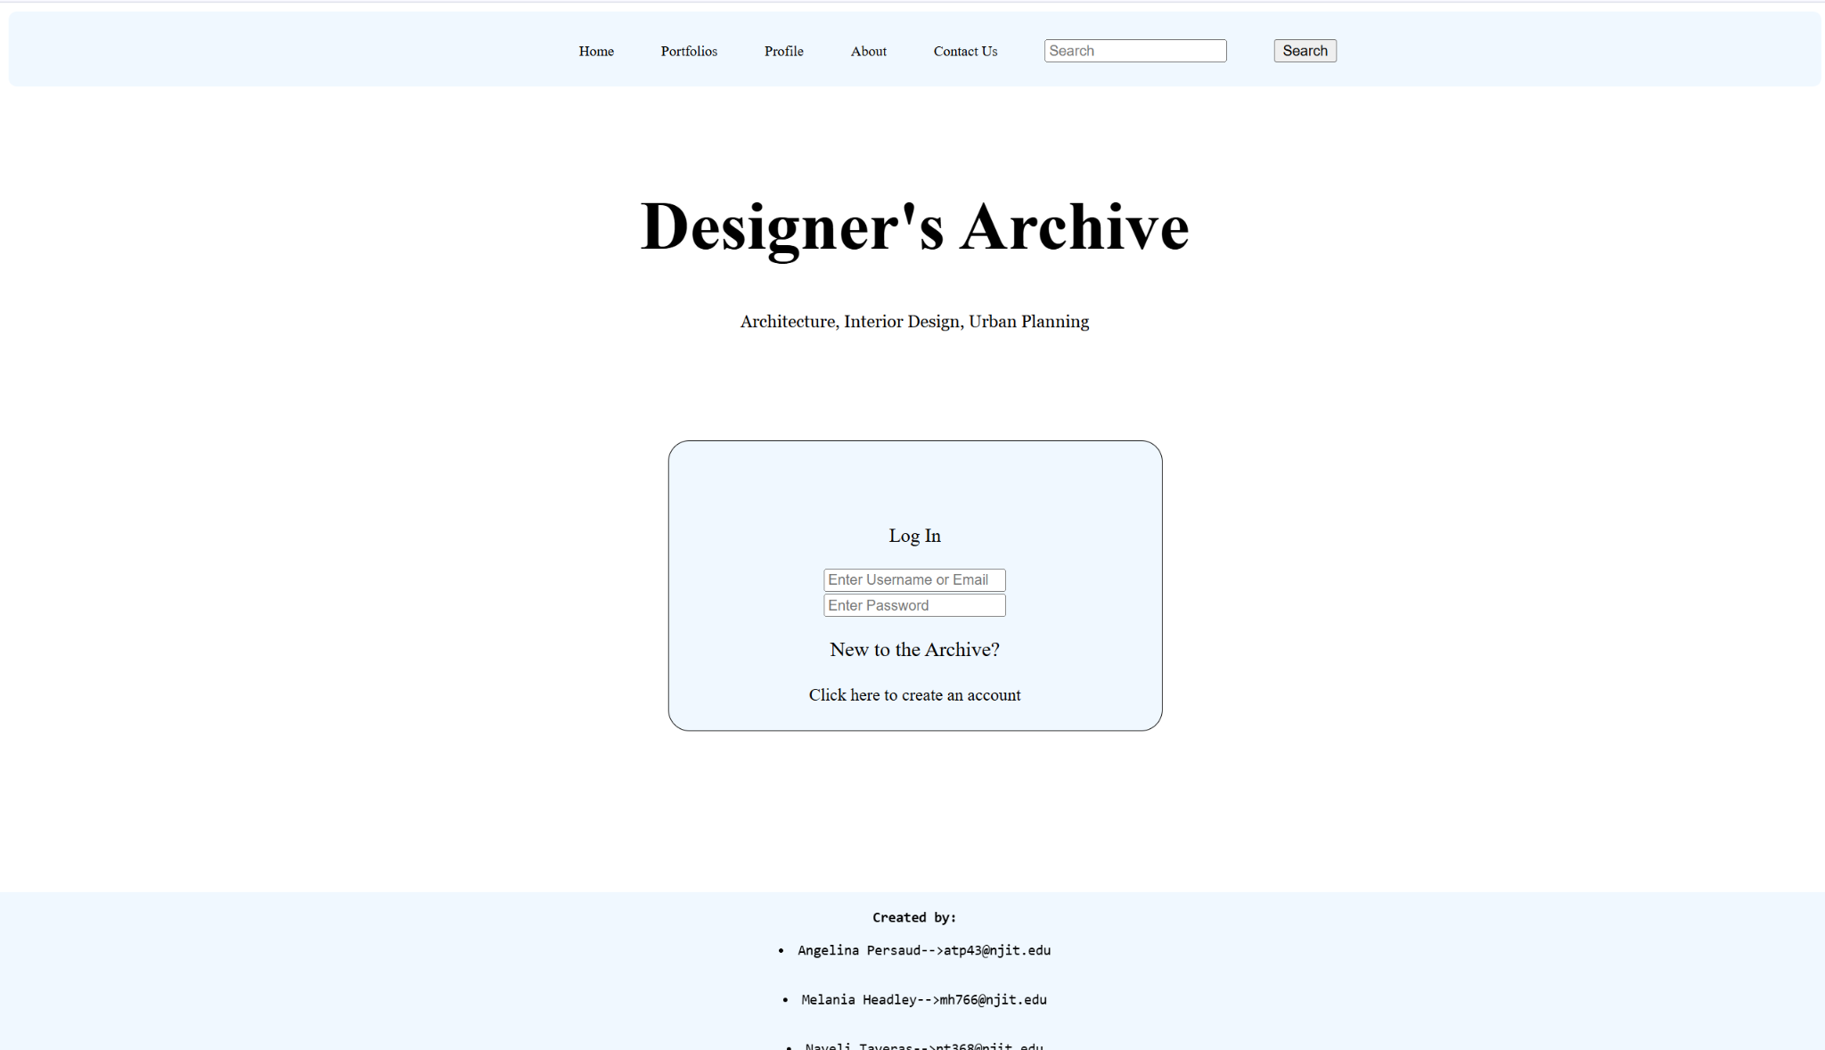
CS Midterm Project
Designer’s Archive
Designer’s
Archive
PORTFOLIO WEBSITE
Made by: Angelina Persaud, Nayeli Taveras, Melania Headley, Nicole Tran
Section: 005 Group 12

Slide 2
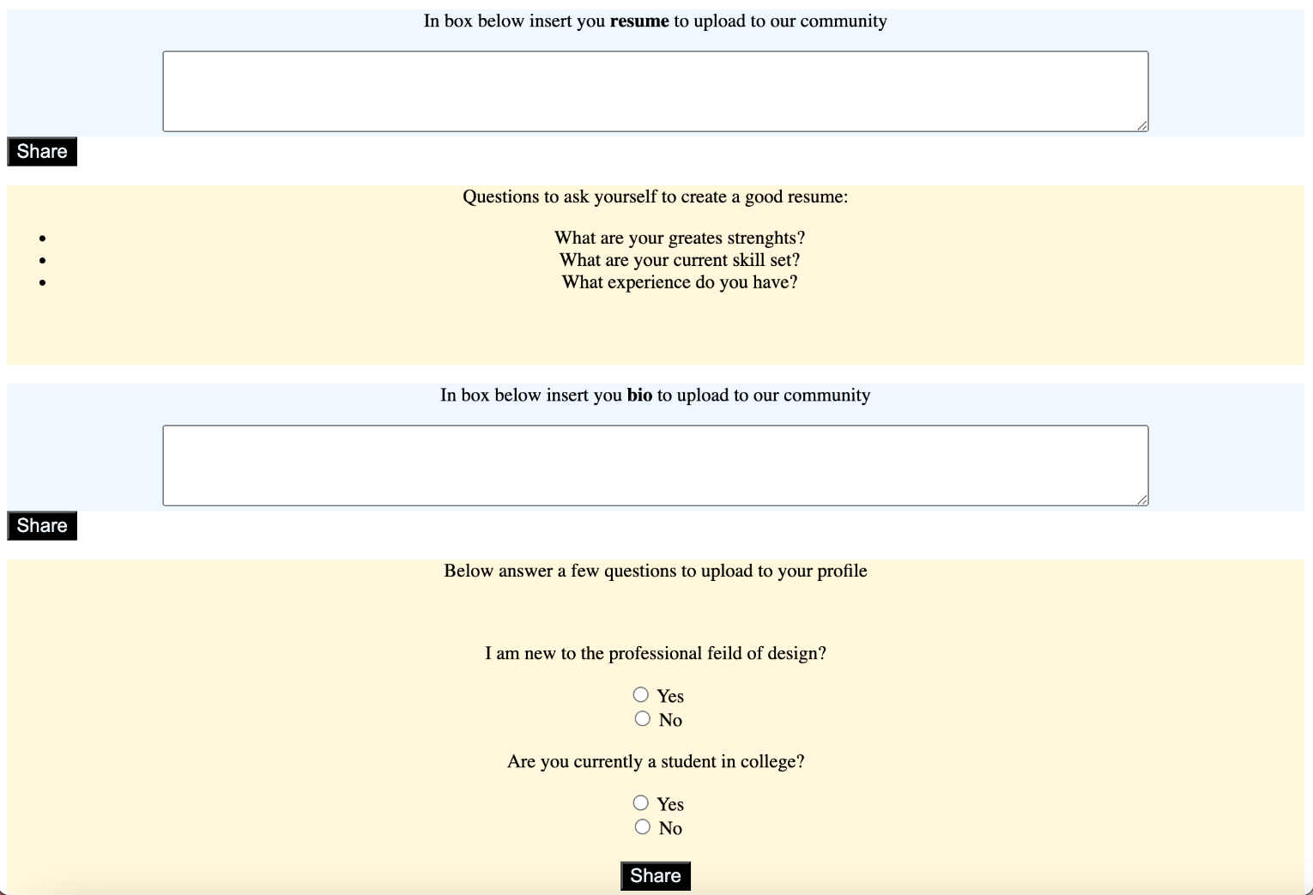
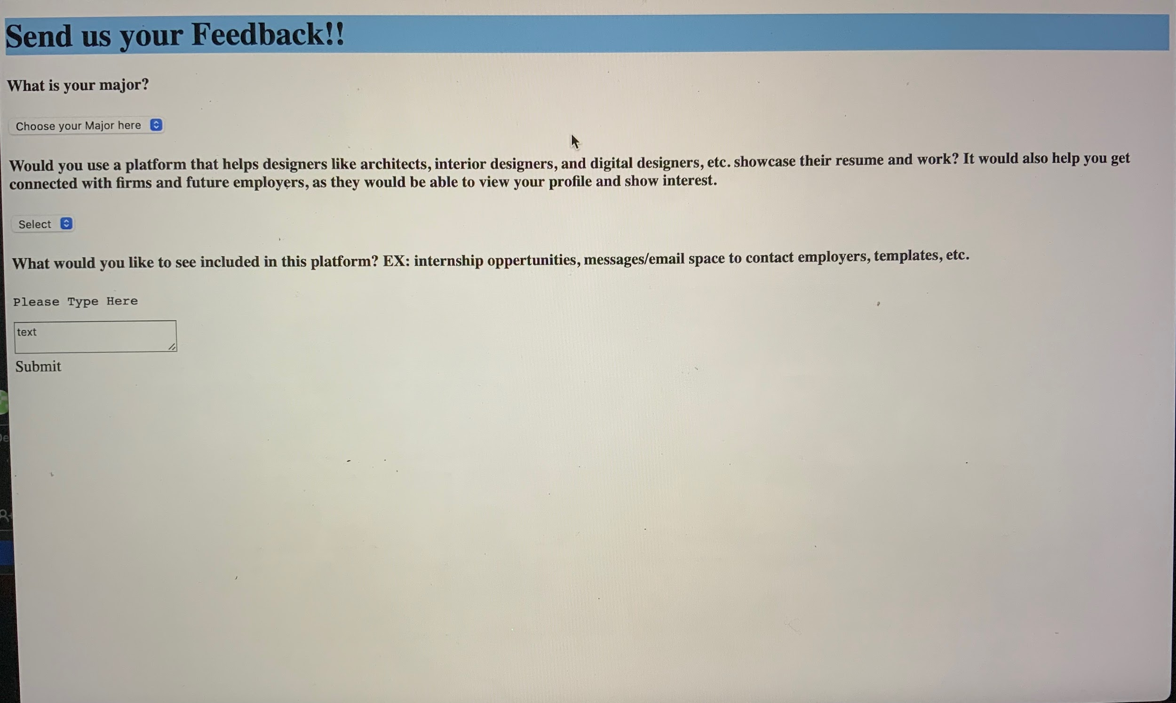
Designer’s Archive
Our Project
Our project is a website made for student designers that are looking for a space to begin documenting their work.
Users can create an account to upload their work and create portfolio pages for others to view like firms and future employers.
So far, we have worked on features such as:
Login screen, header, footer, feedback page
Different pages included in the nav bar such as home, contact, about, profile, etc.

Slide 3
Designer’s Archive
Our Roles and Responsibilities
Angelina
Front-end Web Developer
Designing Html and css for various pages
Helping to record struggles faced and complete progress reports.
Nayeli
Planner and editor
Requirement gathering and analysis
Prioritization of tasks
Helping with css and final presentation
Melania
Planning Assistant
Created mockups
Helped with css and html
Nicole
Project Manager/Web Developer
Created/organized documents for reports 1&2 and the final presentation
Focused on developing CSS for page layouts

Slide 4
Designer’s Archive
Analysis
Project
Tasks available in Designer Archives:
Space to upload portfolio
Can also see others portfolios
Space to upload resume and bio
Questions available to be answered from quizzes provided to get a more personalized bio
Competing websites:
Adobe Portfolio
Squarespace
Webflow
Unlike theses websites ours:
Is not only a place to design a portfolio but also a place to share it with a community of designers
Can receive feedback/comments from viewers

Slide 5
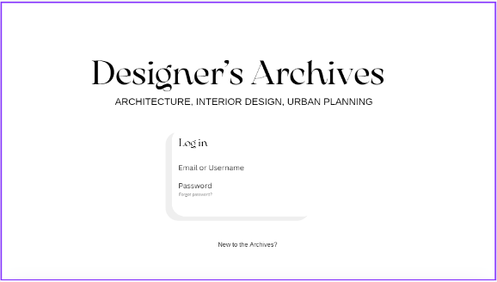
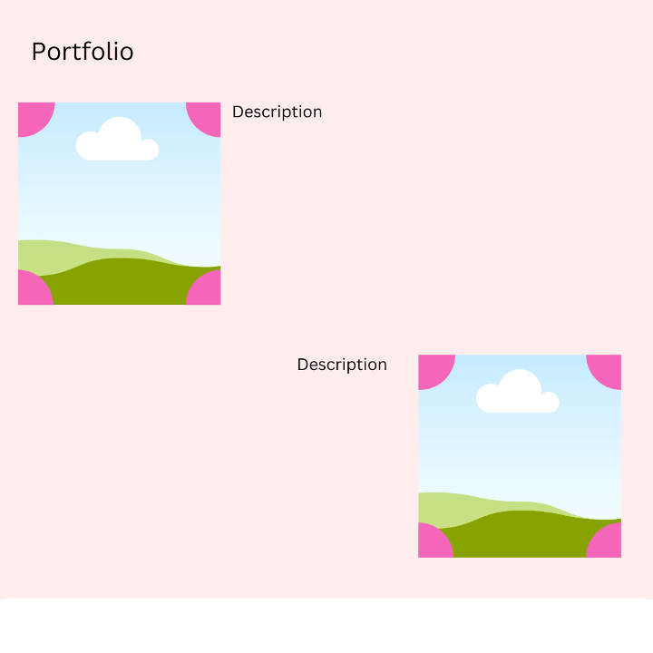
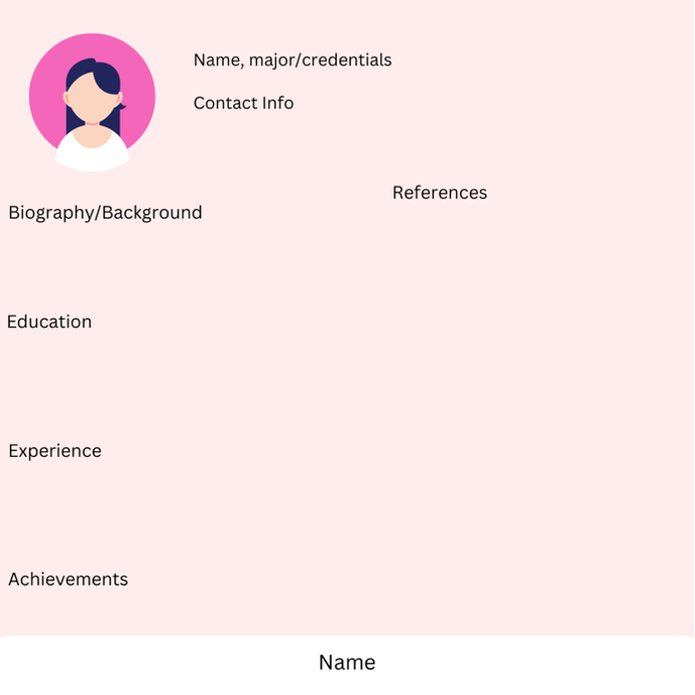
Designer’s Archive
Mock-ups/Feedback
We took a total of 30 surveys and 100% said that they would utilize the website. They want to see that we include internship opportunities, User templates, live chats with firms, place that showcases their resumes, portfolio, skills, etc.

Slide 6
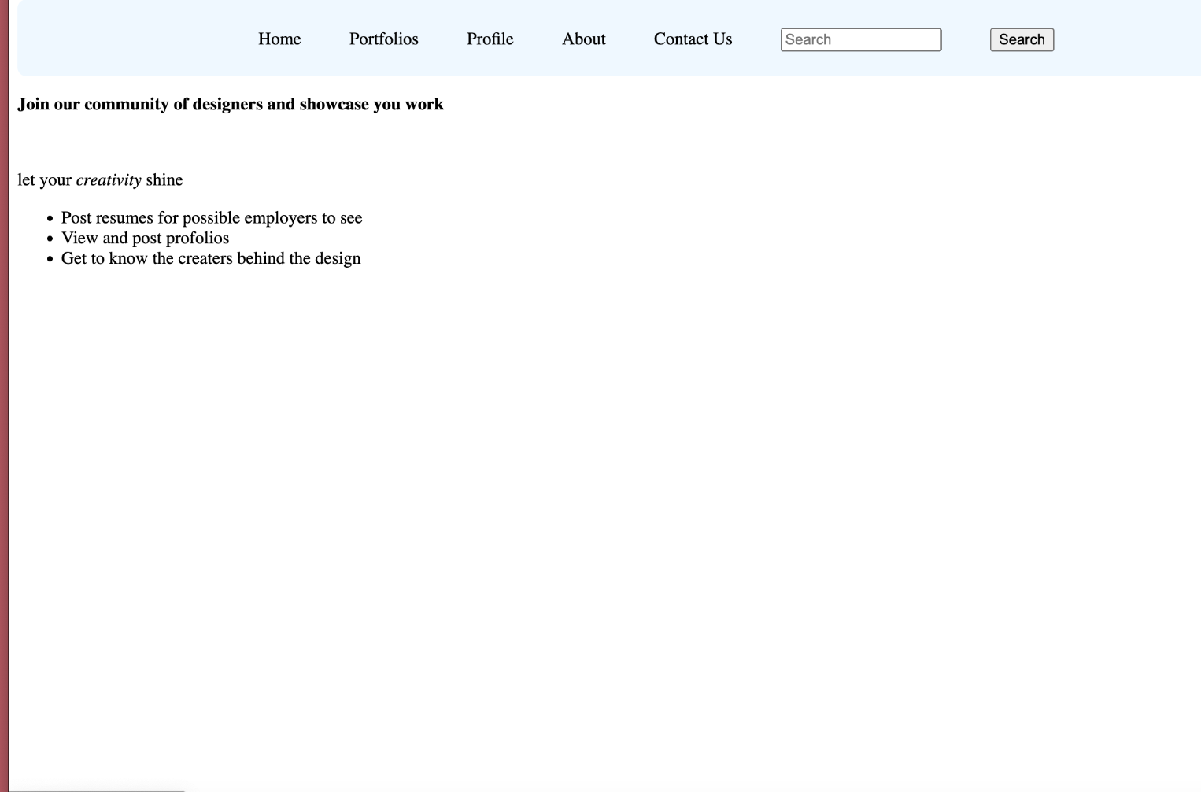
Designer’s Archive
Challenges
Simple challenges with Github, such as some of the font changes would not showing on the website and certain areas would attach to the wrong side of the website.
Coming up with every requirement needed for every user to navigate through the website easily
It was a bit challenging trying to figure out how to code questions that required selecting a choice and giving the user the option to deselect it as well.
We tried setting the footer to auto-margin but it would take up the entire page, etc.

Slide 7
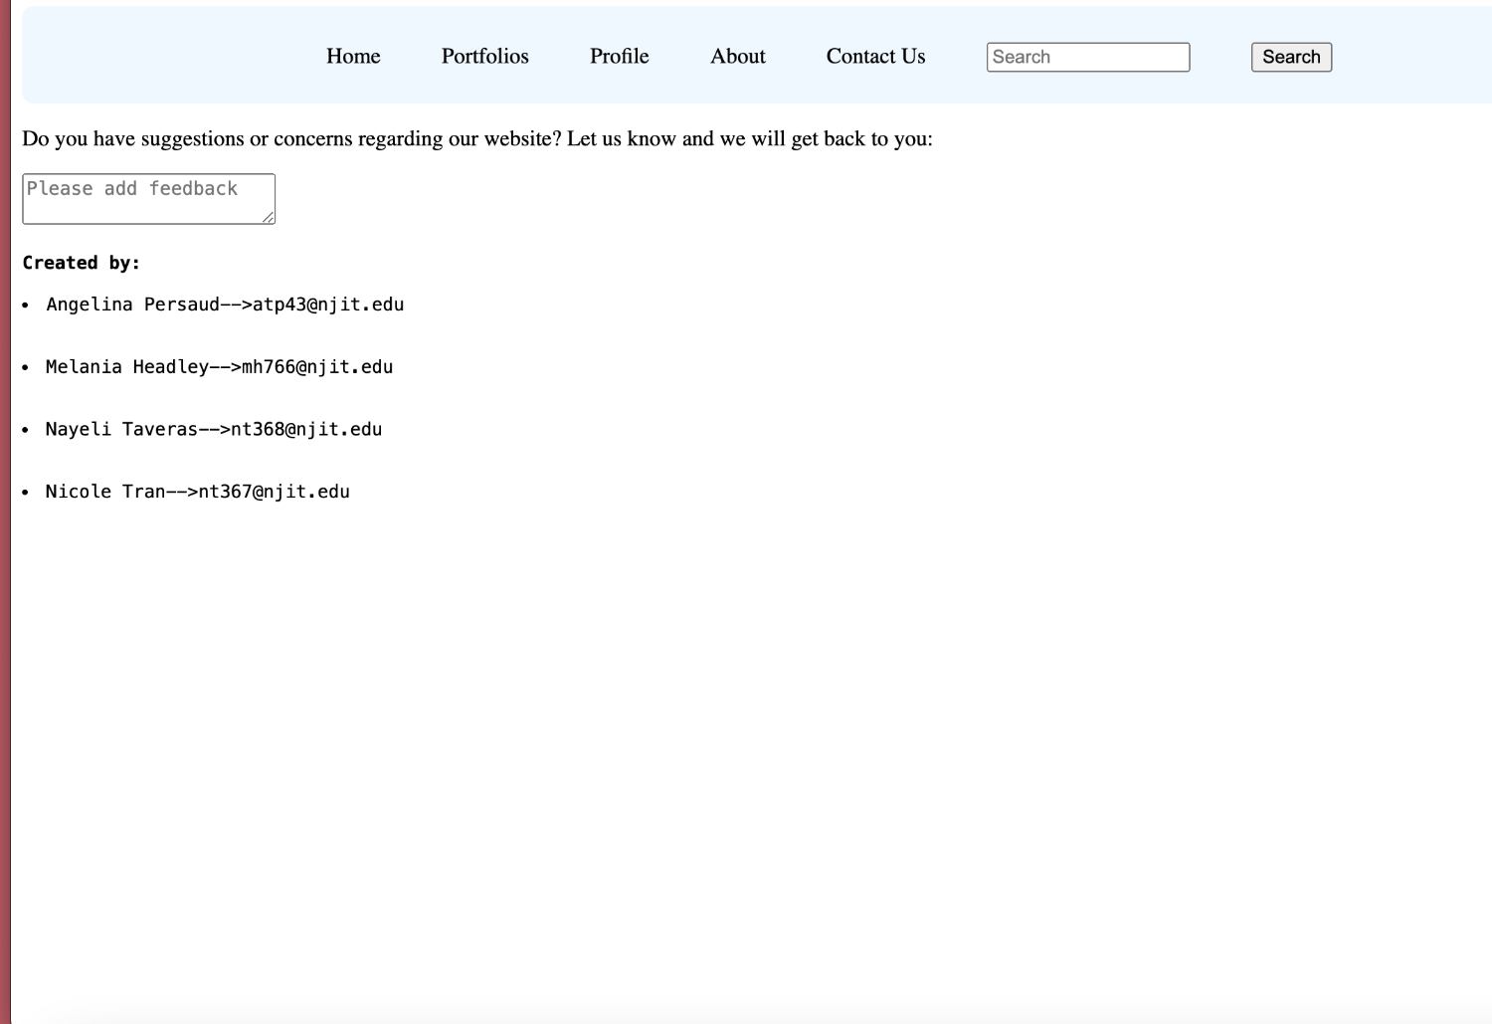

Designer’s Archive
Remaining Tasks &
Approach
Project
Complete HTML and CSS design for all the pages: Create Portfolio page with example portfolios and format About and Contact Pages
Basic functions like search bar, login, and sign up, user profiles,
Have following system and discussion pages for users to give feedback, leave comments, and discuss portfolios

Slide 8
Designer’s Archive
What We Did
Angelina
Melania
Nayeli
Nicole
Created Html code for homepage and profile page
Applied CSS to profile page and in other areas of website
Defined our scope and possible issues we would now be able to address
Helped to brainstorm and come up with a mock-up for the design website
Created the survey/feedback page
Gathered requirements and analysis
Helped edit Html codes and css design of website
Created prioritization of tasks
Helped with midterm presentation
Create and organize document for Project Report 1 & 2
Create and format presentation
Edited basic webpage .html files
Developed .css files for each page

Slide 9
References
https://www.squarespace.com/websites/create-a-portfolio/?channel=pnb&subchannel=go&campaign=pnb-go-us-en-core_verticals_portfolio_tier1-e&subcampaign=(portfolio_portfolio-website_e)&&cid=13842267317&aid=125919727618&tid=kwd-40580193&mt=e&eid=&loc_p_ms=9003544&loc_i_ms=&nw=g&d=c&adid=532615424616&channel2=pnb&subchannel2=go&gad_source=1&gclid=Cj0KCQjwsoe5BhDiARIsAOXVoUsGKCJGr62DbICVvC74BkF_G3So0gEF6SEQwMOHozHo6K1RISppMrAaAtuqEALw_wcB&gclsrc=aw.ds
https://www.wix.com/blog/best-portfolio-websites
https://stock.adobe.com/search?gclid=Cj0KCQjwsoe5BhDiARIsAOXVoUvnItWO-aYP4dCl3ByU2x4WmGnTvZeycy_NLhrTEu9CV8knPGI7TGQaAl1bEALw_wcB&k=architecture%20portfolio%20template&ef_id=Cj0KCQjwsoe5BhDiARIsAOXVoUvnItWO-aYP4dCl3ByU2x4WmGnTvZeycy_NLhrTEu9CV8knPGI7TGQaAl1bEALw_wcB:G:s&s_kwcid=AL!3085!3!514860269679!!!g!!!2089170876!84594855331&as_channel=sem&as_campclass=nonbrand&as_campaign=US|CPRO|Stock|PURCH|DSA_Website_pages|GG||&as_source=google&as_camptype=acquisition&sdid=LZ32SSQD&mv=search&mv2=paidsearch&as_audience=core&gad_source=1

Slide 10
